Slide 1
파이썬 프로그램 만들기
(Durable Rules 패키지)
2021. 04. 01
최 원 희

Slide 2

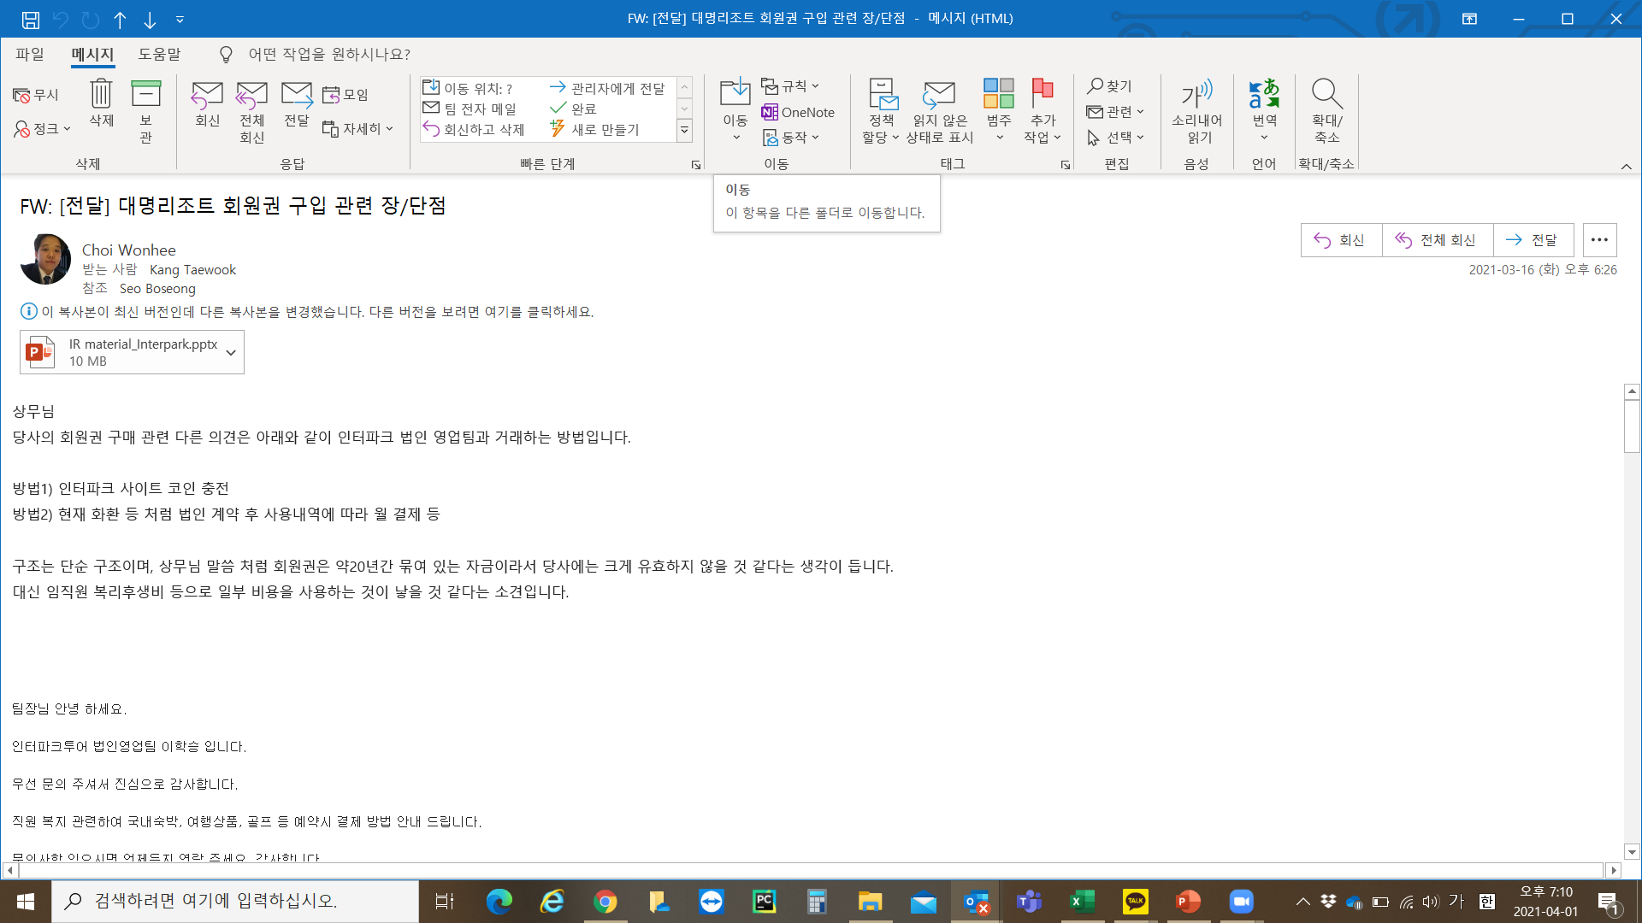
회사 내부 임직원 대상 복리후생 검토
휴가비 지원
출장비 및 식대 등
상여금
출장비
기타 여비 규정 등

Slide 3
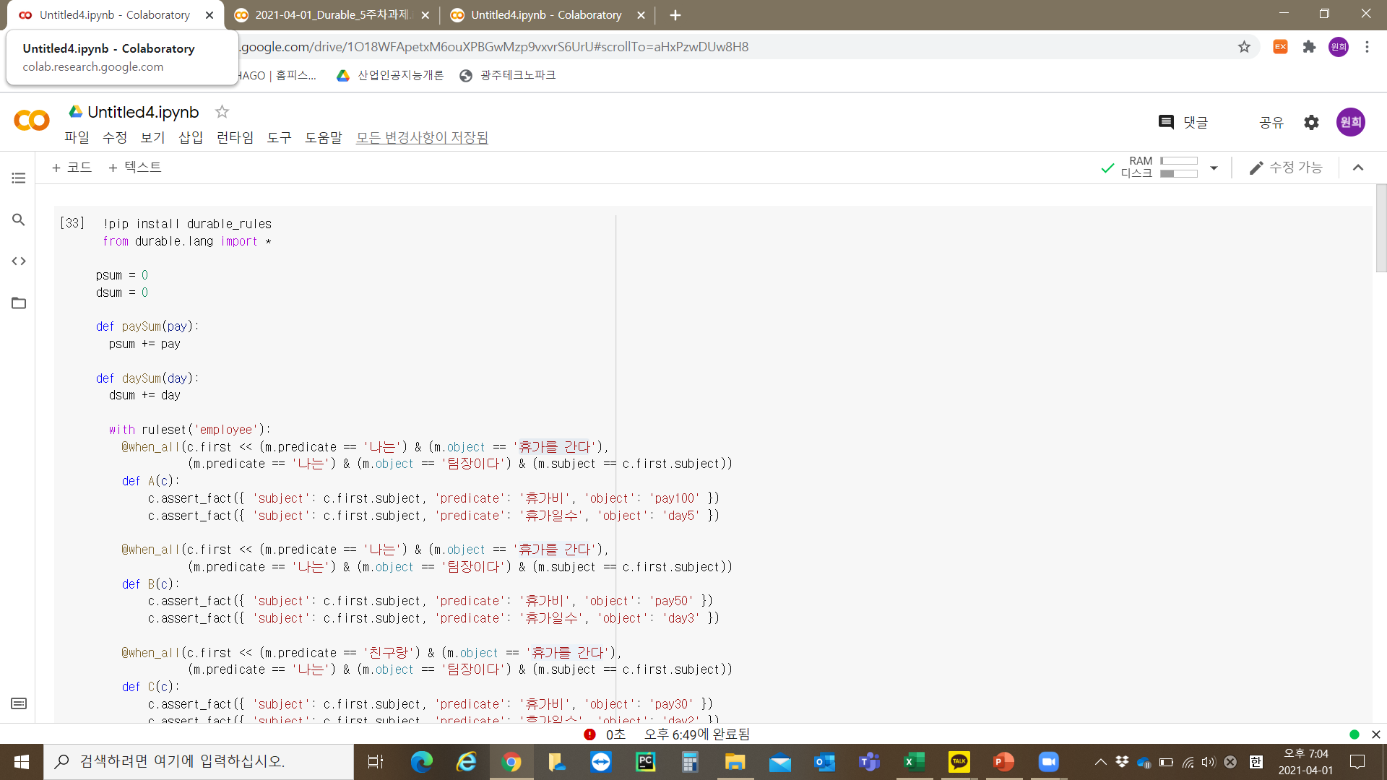

Slide 4
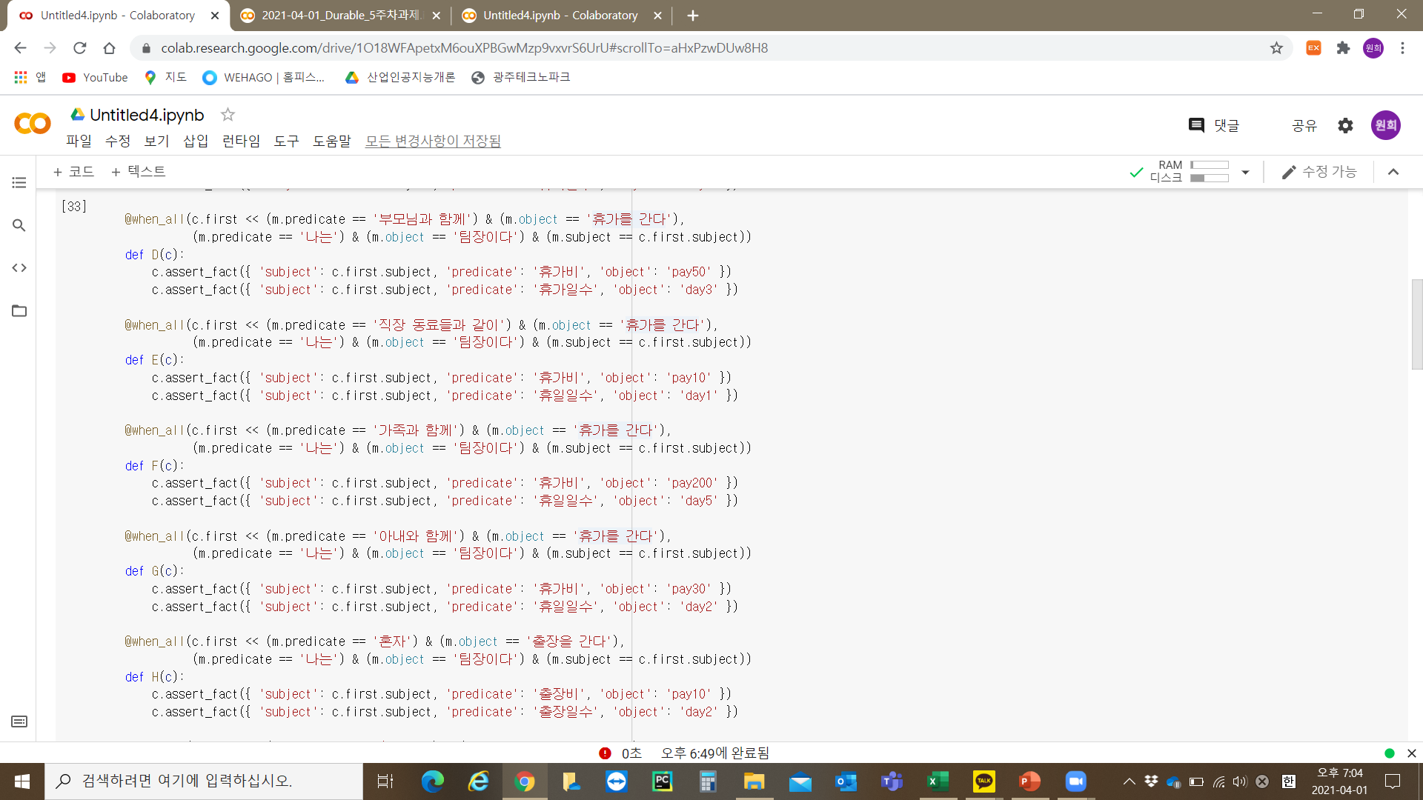

Slide 5


Slide 6
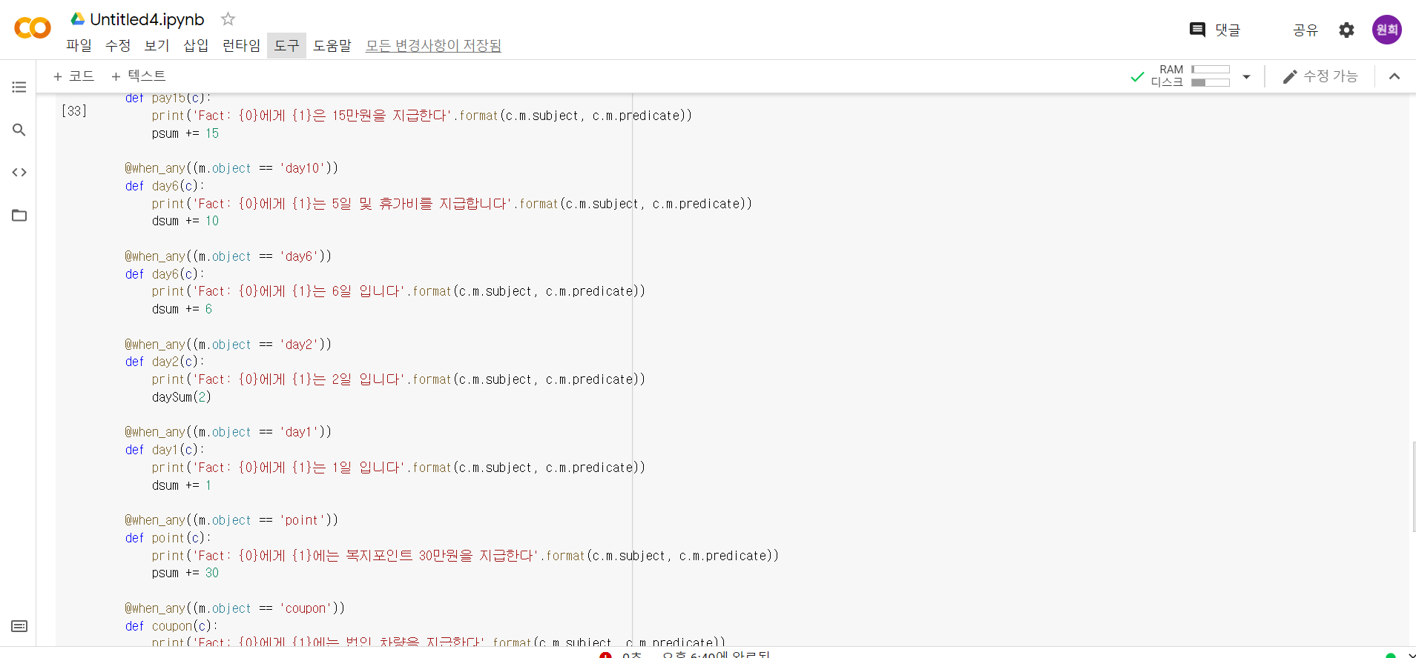

Slide 7
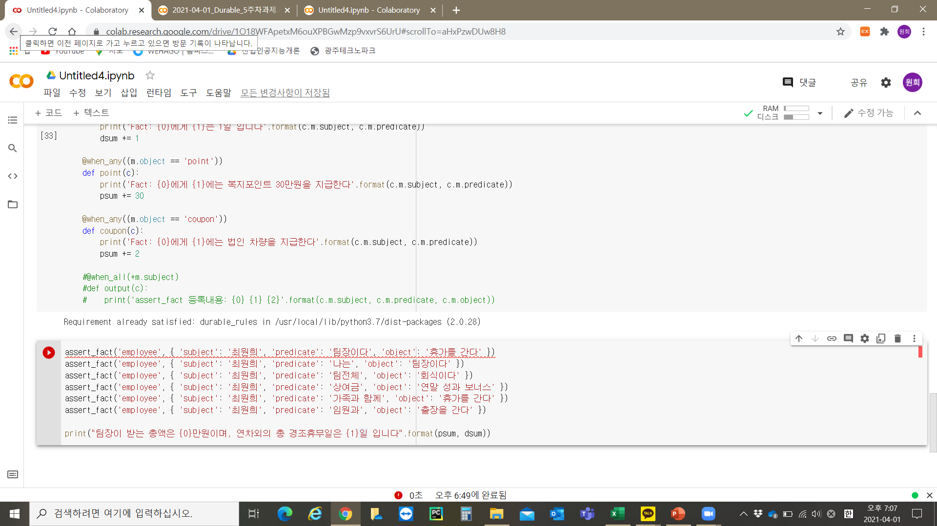

Slide 8
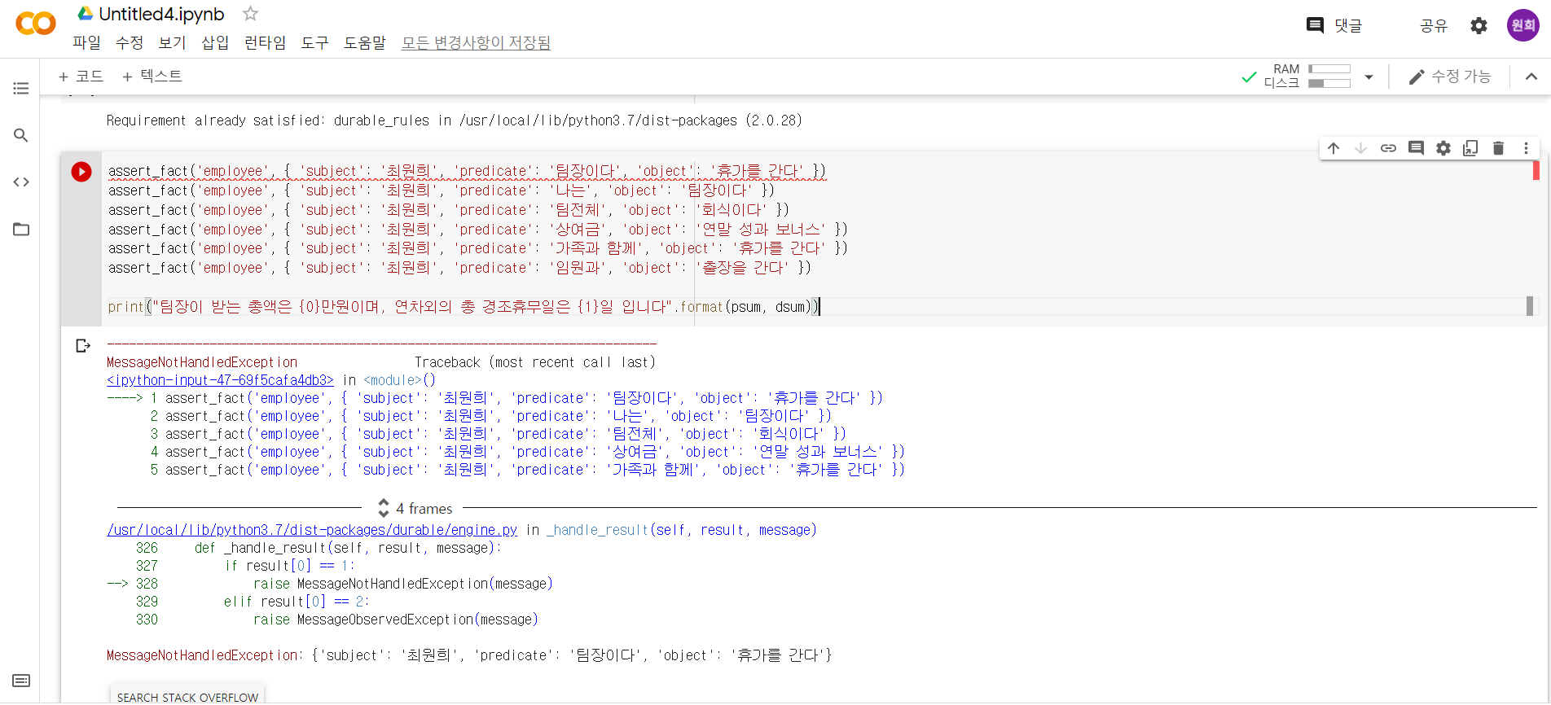

Slide 9
!pip install durable_rules
from durable.lang import *
psum = 0
dsum = 0
def paySum(pay):
psum += pay
def daySum(day):
dsum += day
with ruleset('employee'):
@when_all(c.first << (m.predicate == '나는') & (m.object == '휴가를 간다'),
(m.predicate == '나는') & (m.object == '팀장이다') & (m.subject == c.first.subject))
def A(c):
c.assert_fact({ 'subject': c.first.subject, 'predicate': '휴가비', 'object': 'pay100' })
c.assert_fact({ 'subject': c.first.subject, 'predicate': '휴가일수', 'object': 'day5' })
@when_all(c.first << (m.predicate == '나는') & (m.object == '휴가를 간다'),
(m.predicate == '나는') & (m.object == '팀장이다') & (m.subject == c.first.subject))
def B(c):
c.assert_fact({ 'subject': c.first.subject, 'predicate': '휴가비', 'object': 'pay50' })
c.assert_fact({ 'subject': c.first.subject, 'predicate': '휴가일수', 'object': 'day3' })
@when_all(c.first << (m.predicate == '친구랑') & (m.object == '휴가를 간다'),
(m.predicate == '나는') & (m.object == '팀장이다') & (m.subject == c.first.subject))
def C(c):
c.assert_fact({ 'subject': c.first.subject, 'predicate': '휴가비', 'object': 'pay30' })
c.assert_fact({ 'subject': c.first.subject, 'predicate': '휴가일수', 'object': 'day2' })
@when_all(c.first << (m.predicate == '부모님과 함께') & (m.object == '휴가를 간다'),
(m.predicate == '나는') & (m.object == '팀장이다') & (m.subject == c.first.subject))
def D(c):
c.assert_fact({ 'subject': c.first.subject, 'predicate': '휴가비', 'object': 'pay50' })
c.assert_fact({ 'subject': c.first.subject, 'predicate': '휴가일수', 'object': 'day3' })
@when_all(c.first << (m.predicate == '직장 동료들과 같이') & (m.object == '휴가를 간다'),
(m.predicate == '나는') & (m.object == '팀장이다') & (m.subject == c.first.subject))
def E(c):
c.assert_fact({ 'subject': c.first.subject, 'predicate': '휴가비', 'object': 'pay10' })
c.assert_fact({ 'subject': c.first.subject, 'predicate': '휴일일수', 'object': 'day1' })
@when_all(c.first << (m.predicate == '가족과 함께') & (m.object == '휴가를 간다'),
(m.predicate == '나는') & (m.object == '팀장이다') & (m.subject == c.first.subject))
def F(c):
c.assert_fact({ 'subject': c.first.subject, 'predicate': '휴가비', 'object': 'pay200' })
c.assert_fact({ 'subject': c.first.subject, 'predicate': '휴일일수', 'object': 'day5' })
소
스
코
드

Slide 10
@when_all(c.first << (m.predicate == '아내와 함께') & (m.object == '휴가를 간다'),
(m.predicate == '나는') & (m.object == '팀장이다') & (m.subject == c.first.subject))
def G(c):
c.assert_fact({ 'subject': c.first.subject, 'predicate': '휴가비', 'object': 'pay30' })
c.assert_fact({ 'subject': c.first.subject, 'predicate': '휴일일수', 'object': 'day2' })
@when_all(c.first << (m.predicate == '혼자') & (m.object == '출장을 간다'),
(m.predicate == '나는') & (m.object == '팀장이다') & (m.subject == c.first.subject))
def H(c):
c.assert_fact({ 'subject': c.first.subject, 'predicate': '출장비', 'object': 'pay10' })
c.assert_fact({ 'subject': c.first.subject, 'predicate': '출장일수', 'object': 'day2' })
@when_all(c.first << (m.predicate == '(임원과') & (m.object == '출장을 간다'),
(m.predicate == '나는') & (m.object == '팀장이다') & (m.subject == c.first.subject))
def I(c):
c.assert_fact({ 'subject': c.first.subject, 'predicate': '출장비', 'object': 'pay30' })
c.assert_fact({ 'subject': c.first.subject, 'predicate': '출장일수', 'object': 'day1' })
@when_all(c.first << (m.predicate == '팀 전체') & (m.object == '출장을 간다'),
(m.predicate == '나는') & (m.object == '팀장이다') & (m.subject == c.first.subject))
def J(c):
c.assert_fact({ 'subject': c.first.subject, 'predicate': '출장비', 'object': 'pay100' })
c.assert_fact({ 'subject': c.first.subject, 'predicate': '출장일수', 'object': 'day5' })
@when_all(c.first << (m.predicate == '점심식대를 지급한다') & (m.object == '식대'))
def K(c):
c.assert_fact({ 'subject': c.first.subject, 'predicate': '식대', 'object': 'pay1' })
@when_all(c.first << (m.predicate == '팀 전체') & (m.object == '회식이다'))
def L(c):
c.assert_fact({ 'subject': c.first.subject, 'predicate': '회식대', 'object': 'pay10' })
@when_any(c.first << (m.predicate == '나는') & ((m.object == '팀장이다') | (m.object == '매니저다')))
def M(c):
c.assert_fact({ 'subject': c.first.subject, 'predicate': '휴가비', 'object': 'point' })
c.assert_fact({ 'subject': c.first.subject, 'predicate': '출장을 간다', 'object': 'coupon' })
@when_any((m.object == 'pay150') & ((m.predicate == '상여금')))
def pay150(c):
print('Fact: {0}에게 {1}은 150만원을 지급한다{2}'.format(c.m.subject, c.m.predicate, psum))
psum += 150
paySum(150)
@when_any((m.object == 'pay100') & ((m.predicate == '상여금') | (m.predicate == '연말 성과 보너스')))
def pay100(c):
print('Fact: {0}에게 {1}은 100만원을 지급한다'.format(c.m.subject, c.m.predicate))
psum += 100
paySum(100)
소
스
코
드

Slide 11
소
스
코
드
@when_any((m.object == 'pay75') & ((m.predicate == '상여금') | (m.predicate == '연말 성과 보너스')))
def pay75(c):
print('Fact: {0}에게 {1}은 75만원을 지급한다'.format(c.m.subject, c.m.predicate))
psum += 75
@when_any((m.object == 'pay50') & ((m.predicate == '상여금') | (m.predicate == '연말 성과 보너스')))
def pay50(c):
print('Fact: {0}에게 {1}은 50만원을 지급한다'.format(c.m.subject, c.m.predicate))
psum += 50
@when_any((m.object == 'pay30') & ((m.predicate == '상여금') | (m.predicate == '연말 성과 보너스')))
def pay30(c):
print('Fact: {0}에게 {1}은 30만원을 지급한다'.format(c.m.subject, c.m.predicate))
psum += 30
@when_any((m.object == 'pay20') & ((m.predicate == '상여금') | (m.predicate == '연말 성과 보너스') | (m.predicate == '팀장')))
def pay20(c):
print('Fact: {0}에게 {1}은 20만원을 지급한다'.format(c.m.subject, c.m.predicate))
psum += 20
@when_any((m.object == 'pay15') & ((m.predicate == '상여금') | (m.predicate == '연말 성과 보너스') | (m.predicate == '팀장')))
def pay15(c):
print('Fact: {0}에게 {1}은 15만원을 지급한다'.format(c.m.subject, c.m.predicate))
psum += 15
@when_any((m.object == 'day10'))
def day6(c):
print('Fact: {0}에게 {1}는 5일 및 휴가비를 지급합니다'.format(c.m.subject, c.m.predicate))
dsum += 10
@when_any((m.object == 'day6'))
def day6(c):
print('Fact: {0}에게 {1}는 6일 입니다'.format(c.m.subject, c.m.predicate))
dsum += 6
@when_any((m.object == 'day2'))
def day2(c):
print('Fact: {0}에게 {1}는 2일 입니다'.format(c.m.subject, c.m.predicate))
daySum(2)
@when_any((m.object == 'day1'))
def day1(c):
print('Fact: {0}에게 {1}는 1일 입니다'.format(c.m.subject, c.m.predicate))
dsum += 1

Slide 12
@when_any((m.object == 'point'))
def point(c):
print('Fact: {0}에게 {1}에는 복지포인트 30만원을 지급한다'.format(c.m.subject, c.m.predicate))
psum += 30
@when_any((m.object == 'coupon'))
def coupon(c):
print('Fact: {0}에게 {1}에는 법인 차량을 지급한다'.format(c.m.subject, c.m.predicate))
psum += 2
#@when_all(+m.subject)
#def output(c):
# print('assert_fact 등록내용: {0} {1} {2}'.format(c.m.subject, c.m.predicate, c.m.object))
소
스
코
드

